Slide 1
CHAPTER 2: SOCIETY AND CHEMICAL PERSPECTIVE
Part II

Slide 2
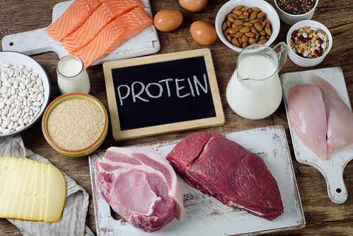
Proteins
Proteins are high molecular mass complex molecules of amino acids present in all living cells. Chemically proteins are condensation polymers (polyamides) in which the monomer units are alpha amino acids.
Chief source of proteins are milk, cheese, pulses, peanuts, fish, meat etc.
On partial hydrolysis, proteins give peptides of varying molecular masses which on complete hydrolysis give alpha- amino acids.

Slide 3
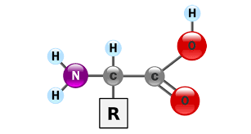
Amino Acids
α-amino acids are building blocks of proteins. They are organic compounds containing both an amino group and carboxyl group. They are represented by the general formula:
The amino acids can be made by our bodies and we do not require them in our diet. They are non-essential amino acids.
The amino acids that are not made inside the body and must be supplied to our diet. They are essential amino acids.

Slide 4
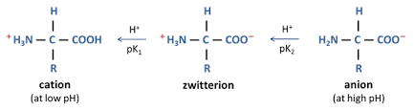
Zwitter ion Structure of Amino Acids
Amino acids exist as dipolar ion called as Zwitter ion. It has positive as well as negative ends within the same molecule. Proton goes from the carboxyl group to amino group. The zwitter ion structure of alpha amino acid may be written as:

Slide 5
Isoelectric point of Amino Acids
The pH or hydrogen ion concentration of the solution at which a particular amino acid does not migrate under the influence of an electric field is called isoelectric point of that amino acid. At isoelectric point, the amino acids have the least solubility in water and this property is used for the separation of different amino acids obtained from the hydrolysis of proteins.

Slide 6
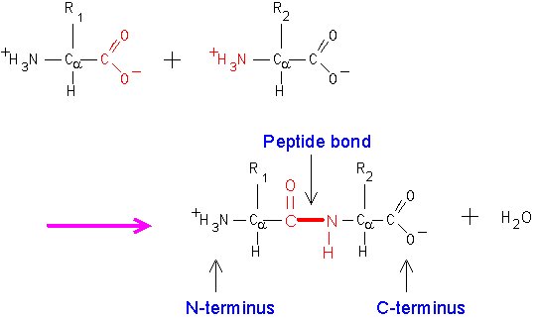
Peptides
These are compounds formed by the condensation of two or more same or different alpha amino aids. The condensation occurs between amino acids with the elimination of water. The resulting –CO-NH- linkage is called a peptide linkage or peptide bond.

Slide 7
Proteins
They are complex nitrogenous molecules which are essential for the growth and maintenance of life. The molecular masses of proteins are very high. Structurally, proteins are long polymers of amino acids linked by peptide bonds.
Classification of Proteins:
1. On the basis of molecular structure:
i) Fibrous proteins
ii) Globular proteins

Slide 8
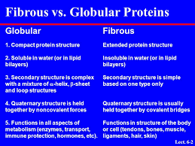

Slide 9
2. On the basis of hydrolysis products
Simple proteins: These are proteins which give amino acids only on hydrolysis with acids or enzymes. E.g. albumins, Globulins, prolamines etc.
Conjugated proteins: These are proteins which on hydrolysis give a non-protein part and alpha amino acids.
Derived proteins: They are products of partial hydrolysis of simple or conjugated proteins. E.g. proteases, peptones, polypeptides etc.

Slide 10
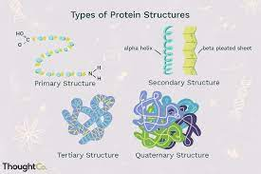
Structure of Proteins

Slide 11
Denaturation of Proteins
It is a process that changes the physical and biological properties of proteins without affecting the chemical composition of the proteins.
It is caused by certain physical or chemical treatment such as changes in pH, temperature, presence of salts or certain chemical agents.
It does not change the primary structure of proteins but results from arrangement of secondary and tertiary structure.

Slide 12
Nucleic Acids
They are biologically important polymers which are present in all living cells. The repeating units are called nucleotides.
There are two types of nucleic acids:
DNA (deoxyribonucleic acid)
RNA (ribonucleic acid)

Slide 13
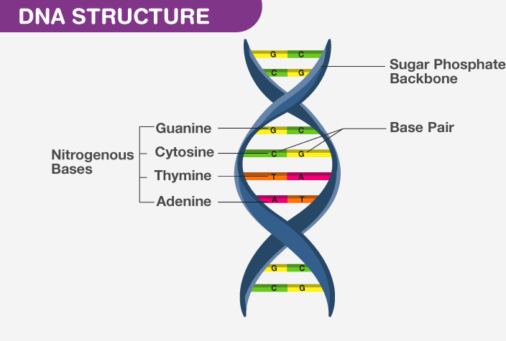
Structure of DNA

Slide 14
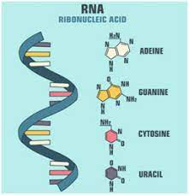
Structure of RNA

Slide 15
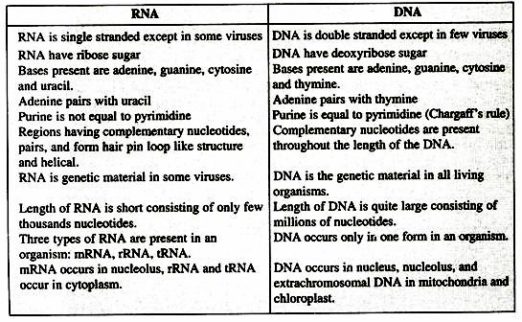
Difference between DNA and RNA

